Slide 1


Slide 2
Dialogue for
Peace Programme
YOUTH PROGRAMME

Slide 3
“The Dialogue for Peace programme was developed in close collaboration between WOSM and the International Dialogue Centre KAICIID”

Slide 4

Let’s start with what is Culture of Peace?

Slide 5
  Culture of Peace
  RESPECT
  right to development
  environmental needs
cultural & linguistic diversity
  fundamental freedoms
  freedom of expression, opinion, and information;
  sovereignty, territorial integrity, and political independence
  life
  human rights
  PROMOTE & PRACTICE
  dialogue
  non-violence
  pluralism
  tolerance
understanding
  justice
  cooperation
  peaceful & non-violence
  settlement of conflicts
  solidarity
  equal opportunities for women and men
  democracy
  EDUCATE
  United Nations 1999

Slide 6
Especially when Resources or Misperceptions are involved.
But conflict does occur…

Slide 7
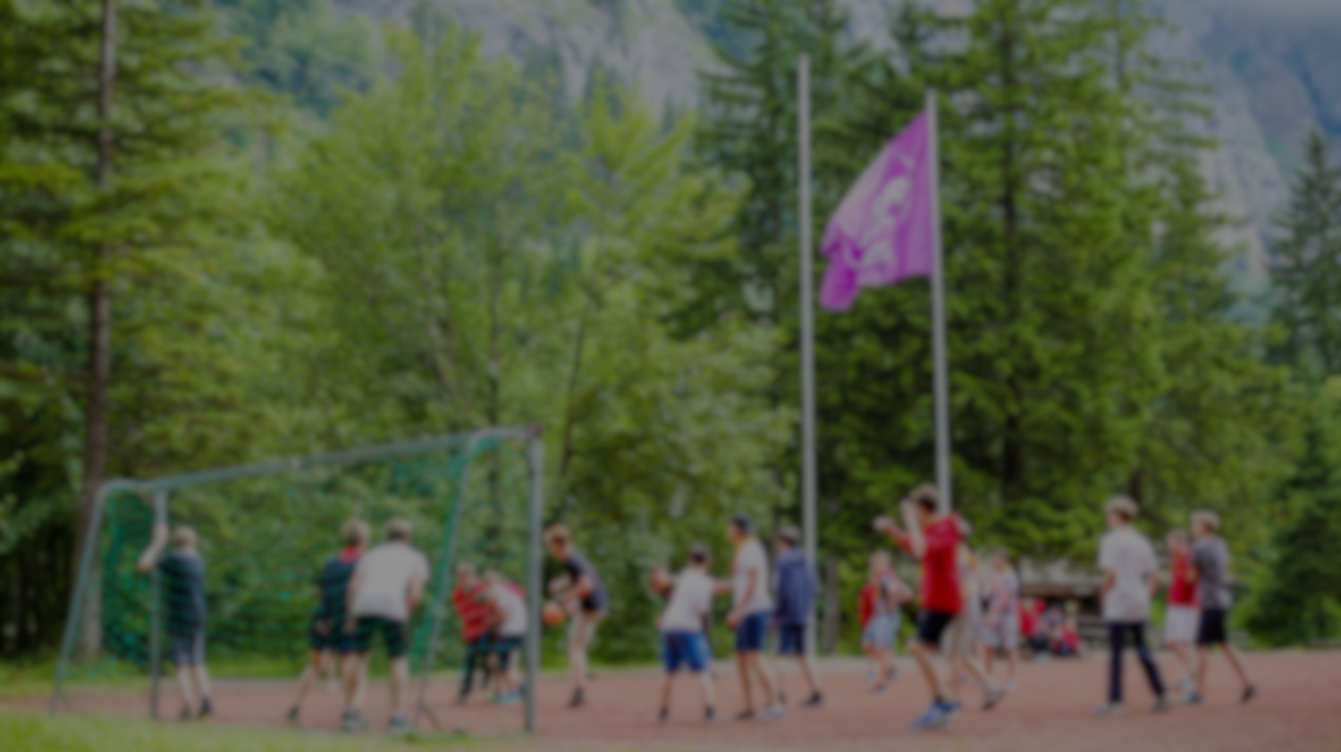
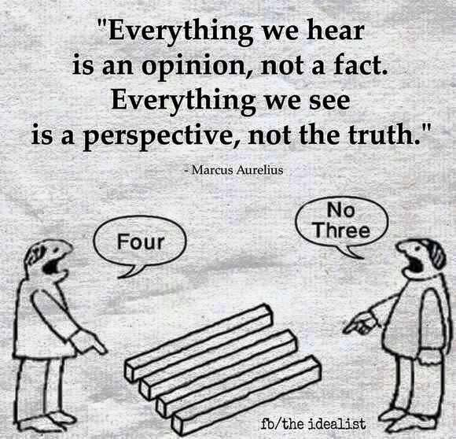

Slide 8
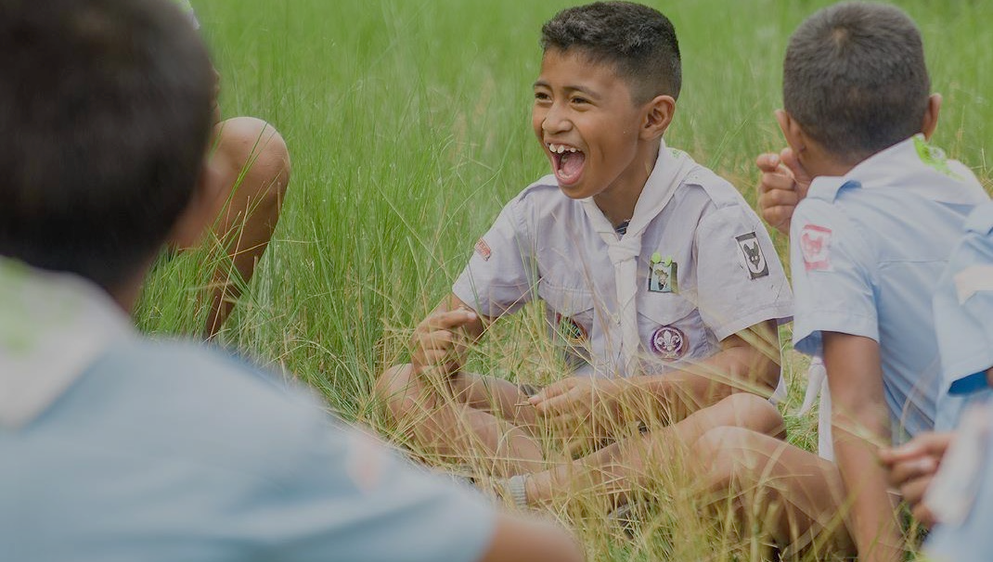
Identity:
Is the qualities, beliefs, personality, looks and. expressions that make a person or group (Handbook of Self and Identity, 2003)
Culture:
“… the way we think, communicate and act within a social community. (The Dialogue Hand Book, 2013)
“software of the mind” (Cohen, 1993)

Slide 9
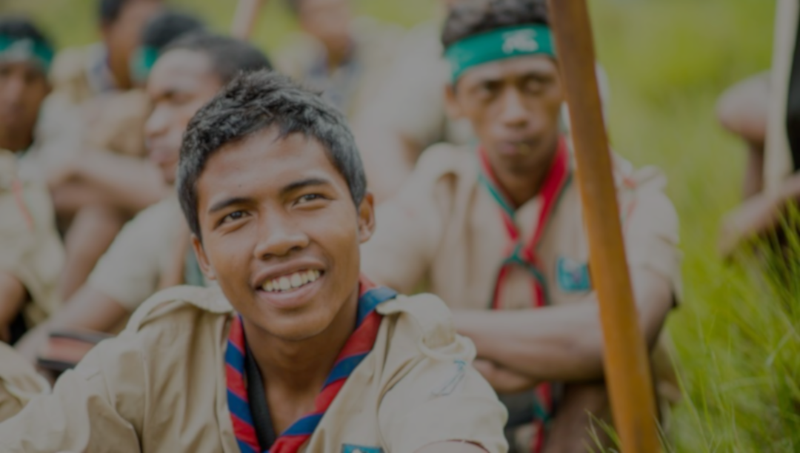
Because… our Identities and Culture influence how we perceive or misperceive people and the world
Notes:
Conflict is not necessarily bad or “a failure
Conflict often is a creative force
Conflict is a natural process
Confronting conflict can lead to new levels of self- discovery,
Managing conflict wisely can lead to enhanced mutual trust, improved teamwork, and greater levels of productivity,
Real creativity is not possible without conflict.

Slide 10
We use Dialogue for mutual understanding…

Slide 11
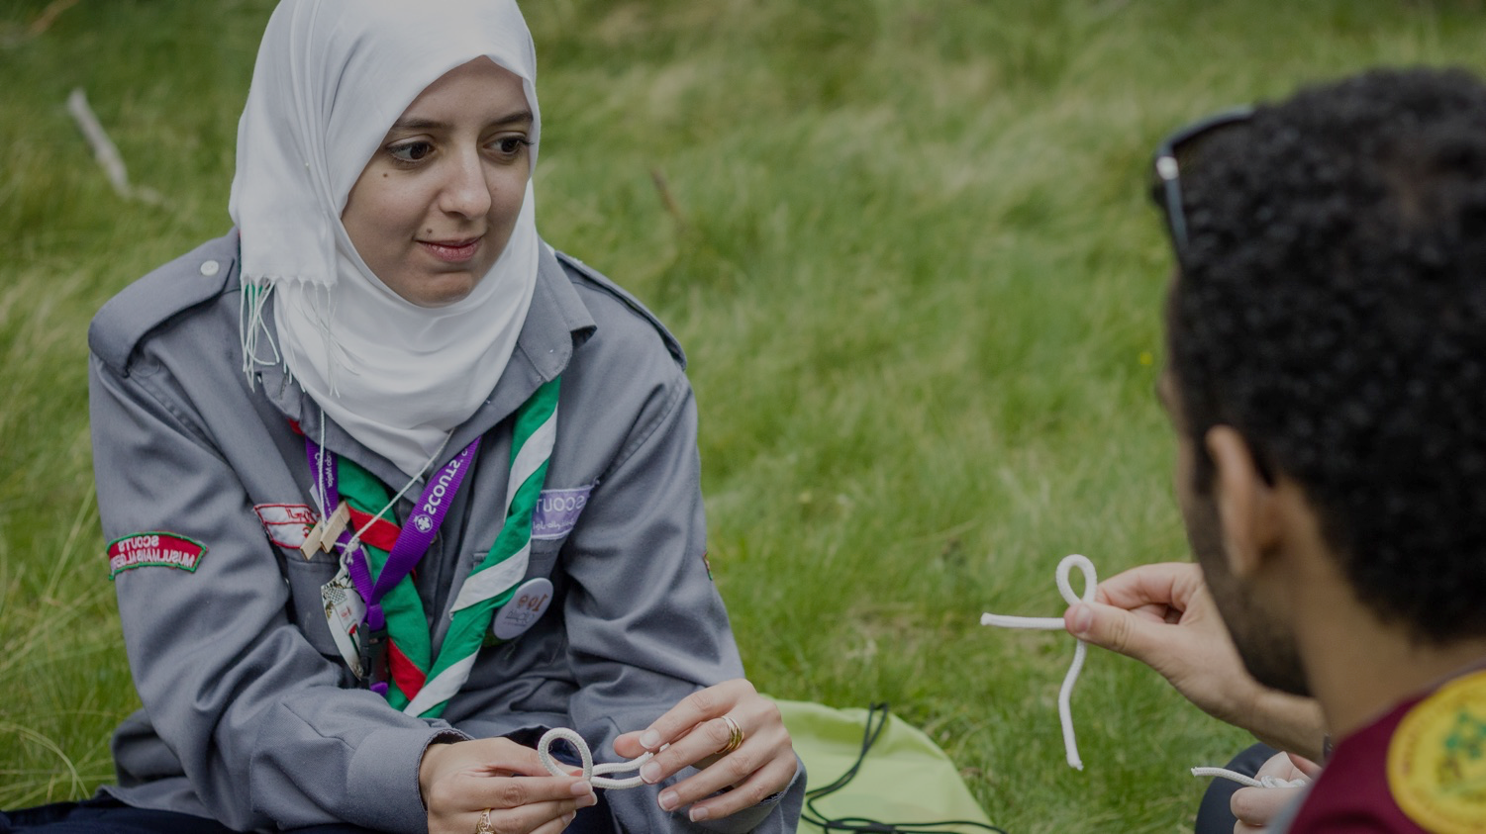
What is
Dialogue?
A safe space or “container” for people to surface their assumptions, to question their previous perceptions and judgments.
An emphasis on questions, inquiry, co-creation, and listening, the uncovering of one’s own assumptions and those of others, a suspension of judgment and a collective search for truth.
A conversation “with a center, not sides” (Bill Isaacs)
Bojer et al. Mapping Dialogue: Essential Tools for Social Change, Taos Institute Publication

Slide 12
Dialogue has many applications…

Slide 13
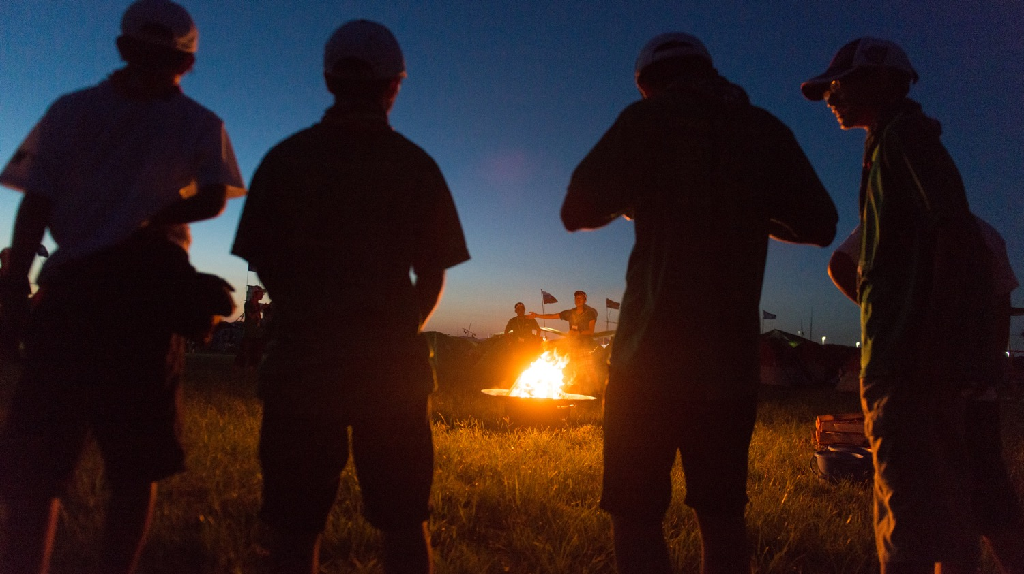
Inter-cultural
Inter-religious
Inter-worldview
Inter-generational
Others
Dialogue

Slide 14
Dialogue is also applicable…
Intra-cultural
Intra-religious
Intra-worldview
Intra-generational
Others
Dialogue

Slide 15
Let’s practice Dialogue

Slide 16
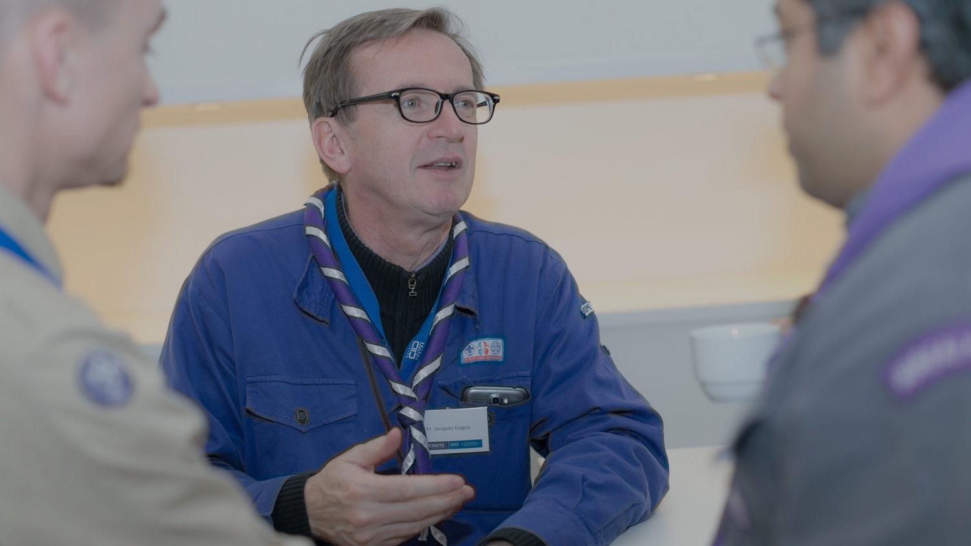
Establish the safe environment,
Approach dialogue with a learning attitude,
Agree on the purpose,
Set the ground rules,
Take risk, surface feelings and confront perceptions,
The relationship comes first,
Gradually address the hard questions and gradually depart them,
Do not quit or avoid the difficult issues,
Expect to be changed,
Bring the change to others.
Ten Principles of Dialogue

Slide 17
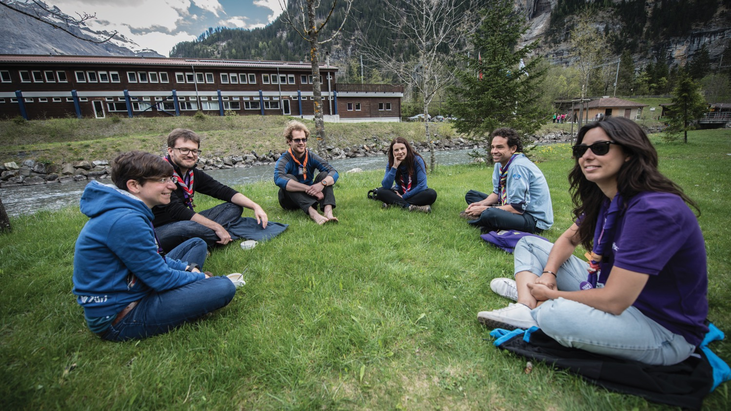
Establish Ground Rules for Dialogue Groups
Confidentiality
Respect difference
No interrupting
Equal time – equal space
No advice
Listen
Speak in the first person – Use “I” statements
Responsibility
Disclosure
Pass

Slide 18
Is Dialogue present in Scouting?

Slide 19
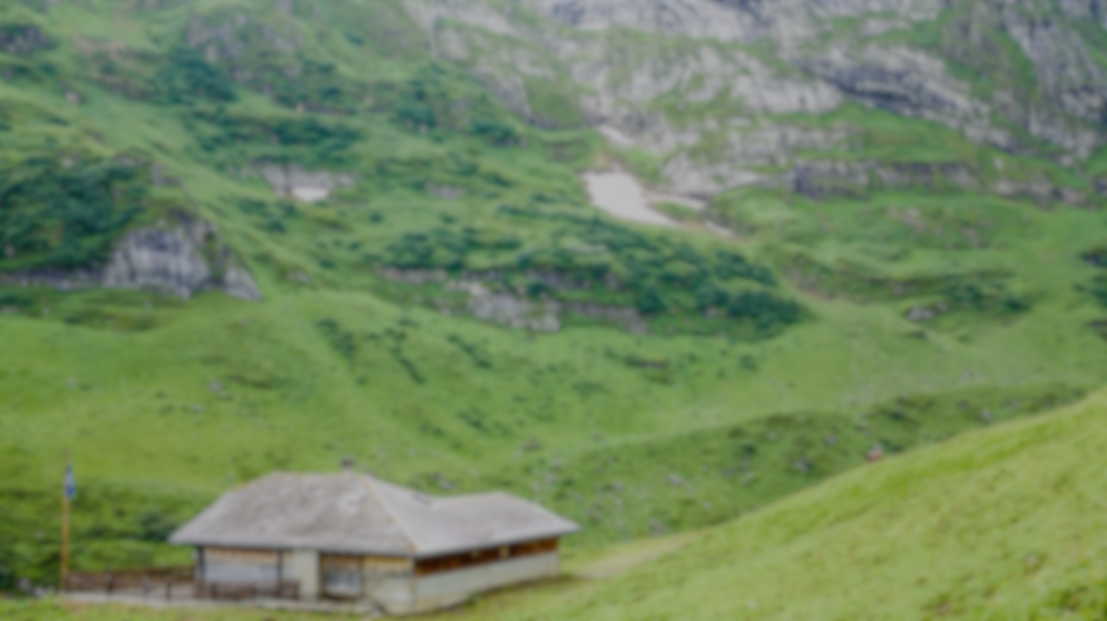

Dialogue for Peace
help Scouts to become aware and
Dialogical
Yes
Notes:
With 3 merit levels

Slide 20
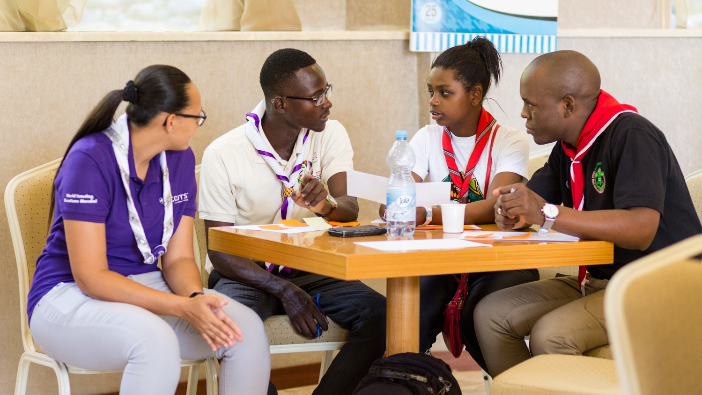
Dialogical
Global Active Citizen
SCOUT
Notes:
With 3 merit levels
pp

Slide 21
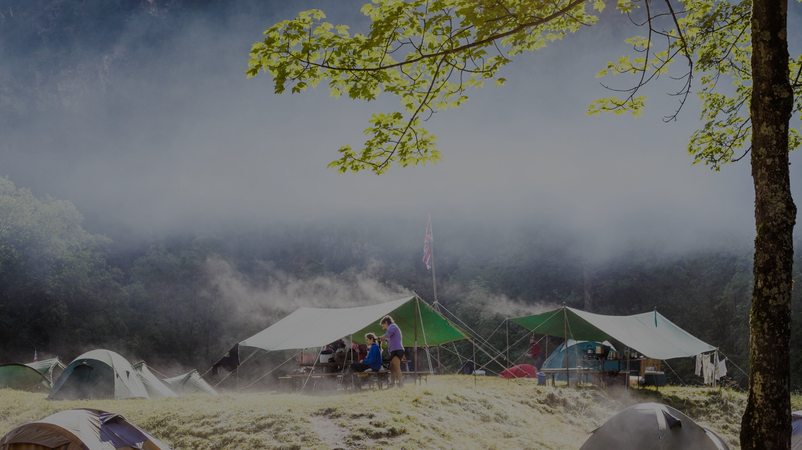




Dialogue for Peace
programme & badge
PERSONAL
Facilitator
Trainer
Rovers and scout leaders implemented by NSO/region
Rovers and scout leaders implemented by NSO/region
1 badge for each age section implemented by unit leader

Slide 22
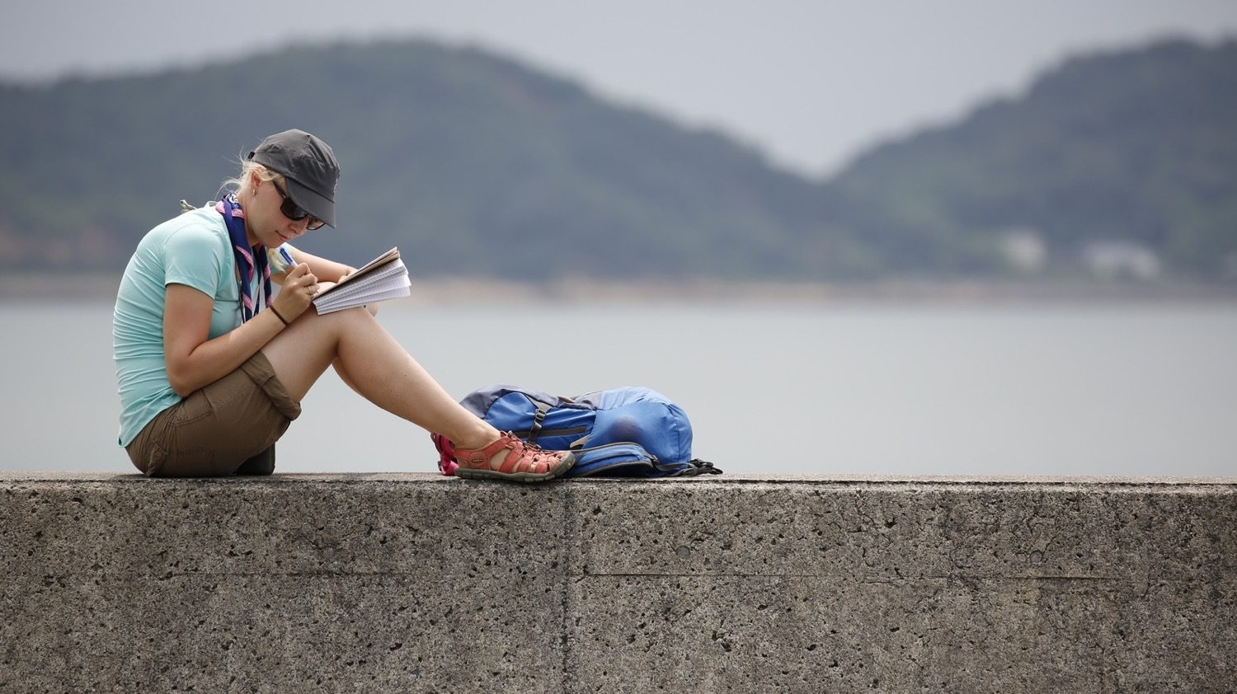
Personal
1 badge for each age section implemented by unit leader
Overall Educational Objectives
Value the need of peace and dialogue in today’s world
Respect all mankind regardless of their faith, gender, age, ethnicity … etc.; and to be able to conduct a constructive dialogue with them
Applying principles of Dialogue as part of one’s value system.
Promote dialogue among peers and community as an essential value toward creating a better world.
Dialogue for Peace
badge

Slide 23
Personal
1 badge for each age section implemented by unit leader
Easy Process:
Dialogue
programme
& badge
Learn
Do

Slide 24
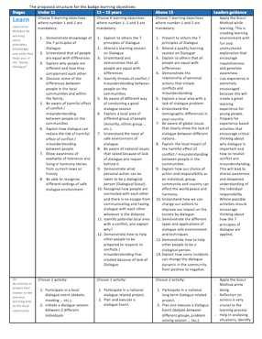
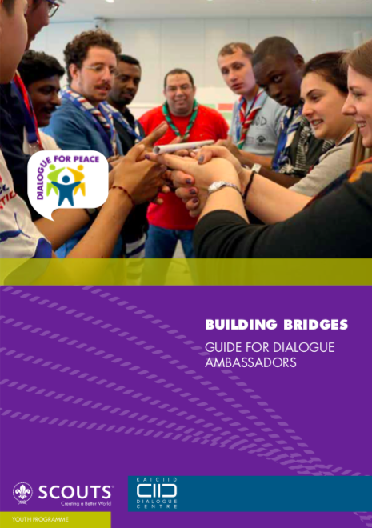
Personal
1 badge for each age section implemented by unit leader using the proposed learning objectives
Dialogue
programme
& badge

Slide 25
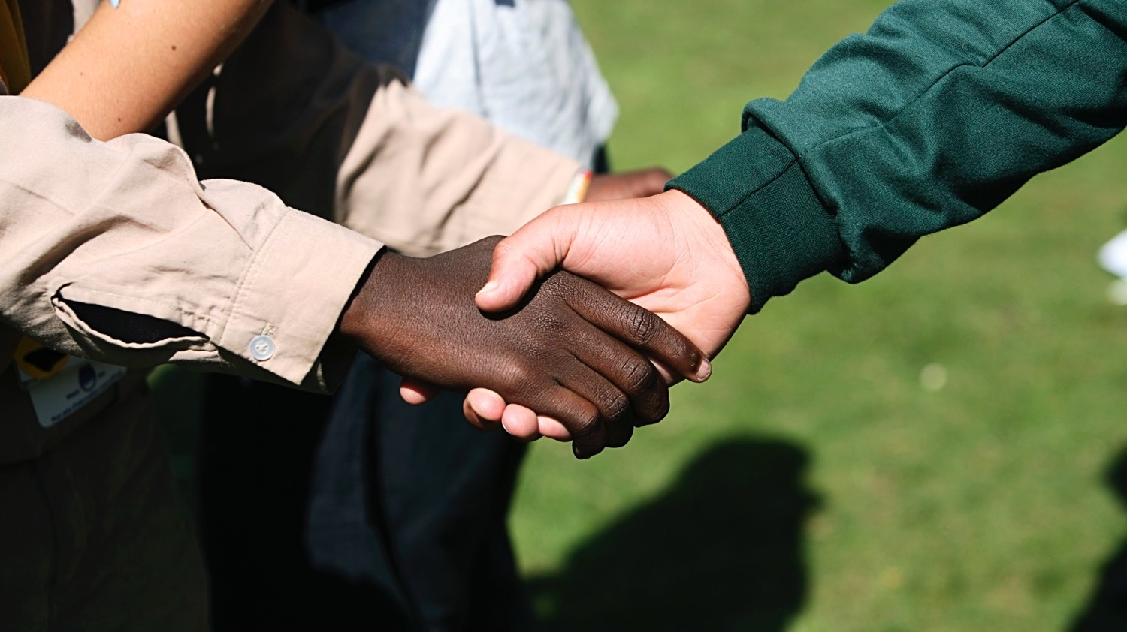
Facilitator
Rovers and scout leaders implemented by NSO/Region
Trainer
Rovers and scout leaders implemented by NSO/Region
Dialogue for Peace
certification

Slide 26
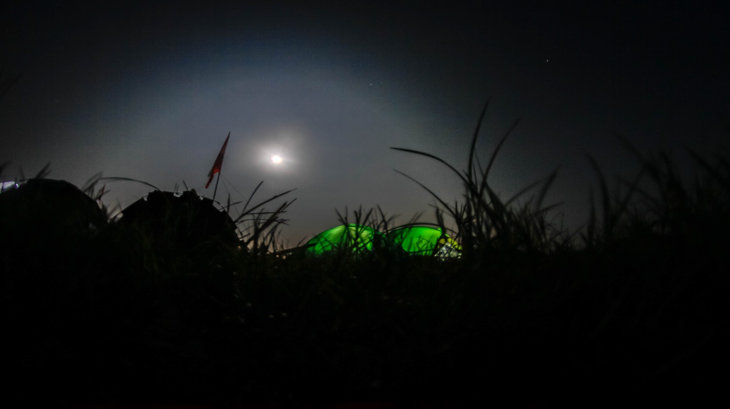












Others…
Notes:
WSEP is part of Better world framework

Slide 27
Thank you!

